Slide 1
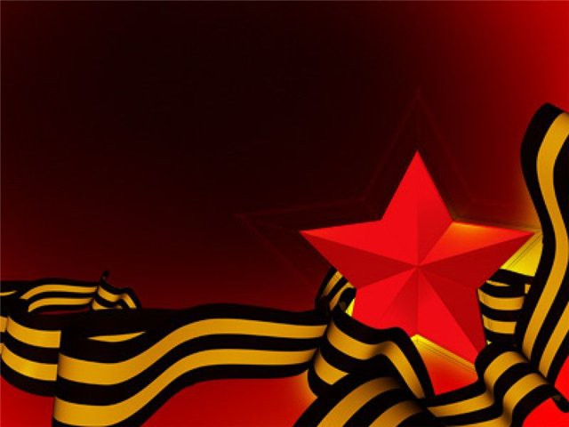
Victory Day
Made by Borisova T.V. school 296 Saint-Petersburg

Slide 2
The 9th of May, 2015 is the 70th anniversary
of the victory over German fascism in
1941-1945.
On June 22, 1941, Germany attacked
the Soviet Union and the Great Patriotic
War began.
It lasted 1418 days and nights.

Slide 3
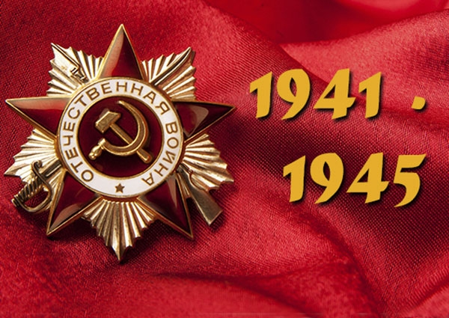
Victory Day is the greatest holiday and all the counties which fought in the Second World War celebrate it.
We must always remember all those who put
an end to fascism and never came back to
their homes.

Slide 4
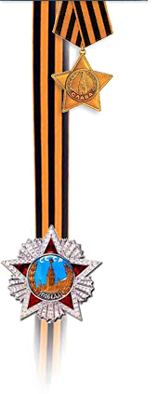
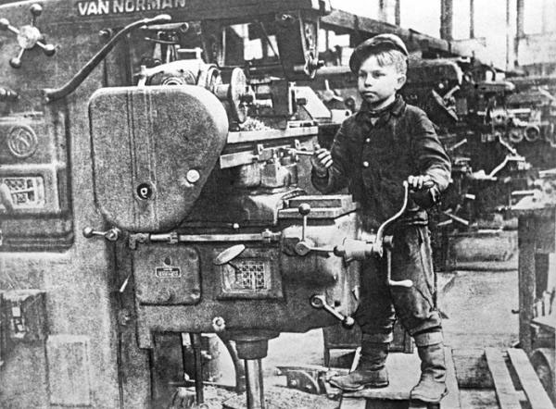
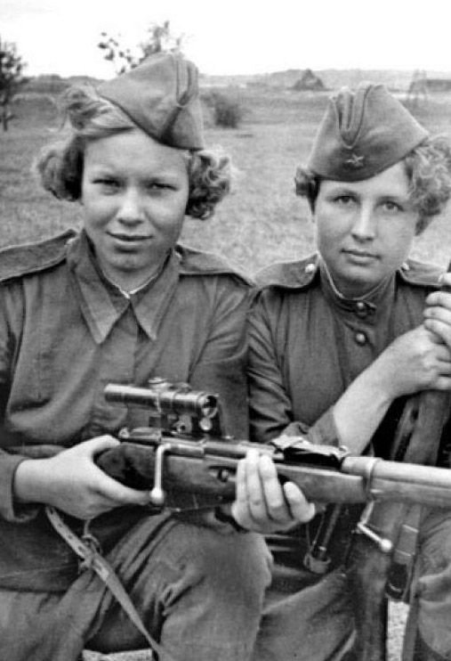
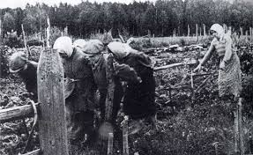
Everyone in the USSR, men and women,
old and young and even children, helped the Soviet Army to fight against the fascists, our enemies.

Slide 5
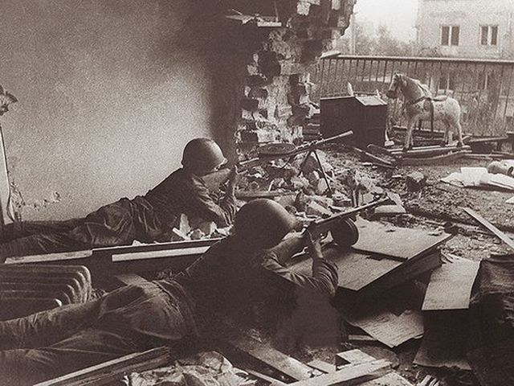
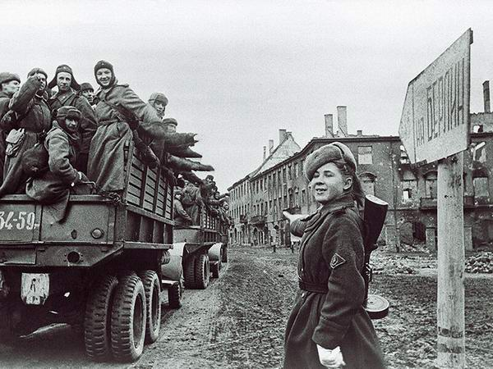
The Soviet soldiers and officers fought bravely at the fronts and there were many women among them. More than 20 million Soviet people gave their lives, defending
their Motherland. They saved the world
from fascism.

Slide 6
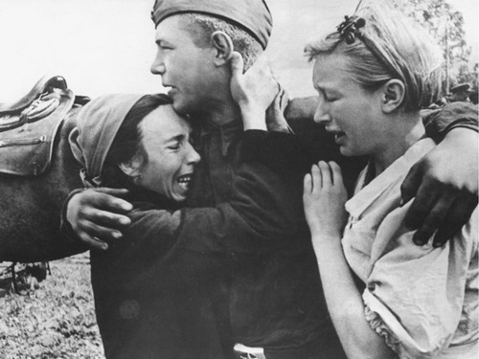
We cannot find a family whose father or son did not fall for our Motherland.

Slide 7
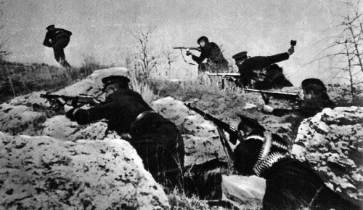
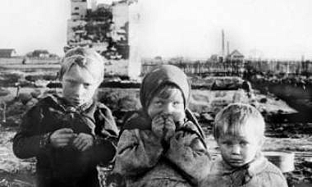
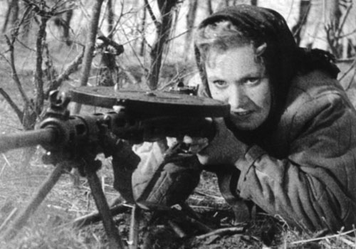
The enemies tried to destroy our cities, towns and villages, but soviet people fought like real heroes to defend our country.

Slide 8
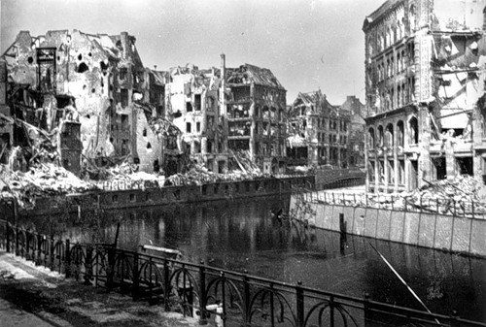
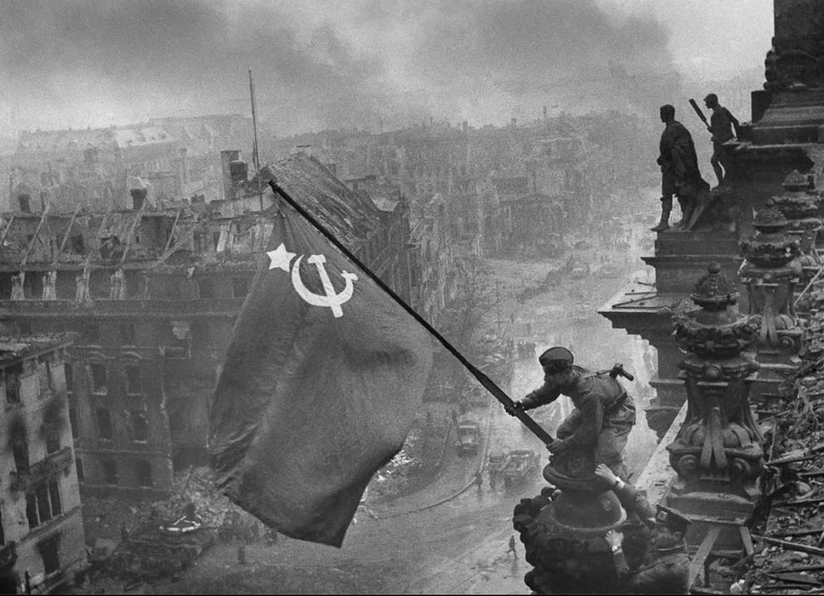
Many countries in Europe were liberated by Soviet Army.

Slide 9
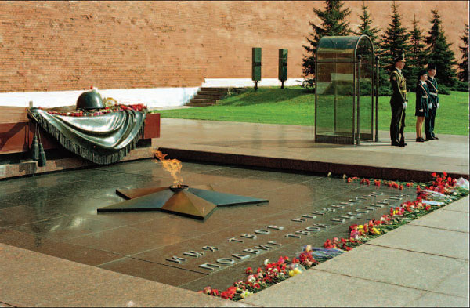
In Moscow on Red Square there is
the Tomb of the Unknown Soldier
where the Eternal Flame is burning.

Slide 10
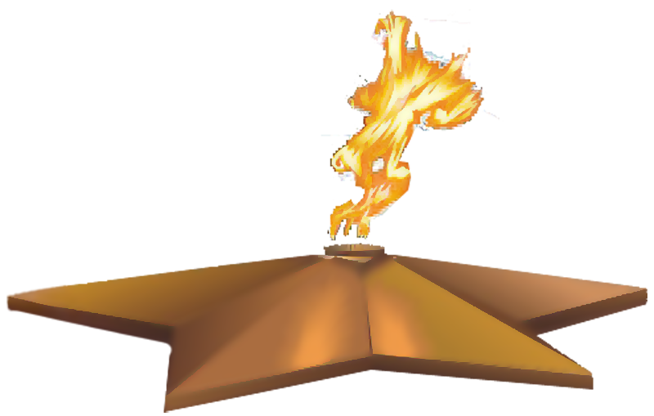
There is a Minute of Silence at 7 p.m.
on the 9th of May.
The names of war heroes will live in
people’s memory forever.

Slide 11
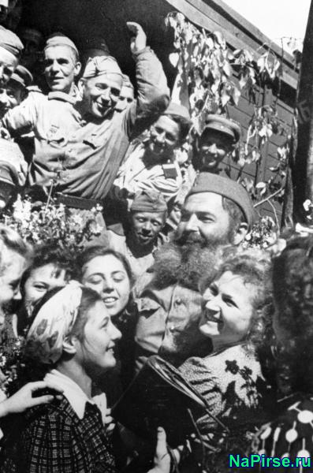
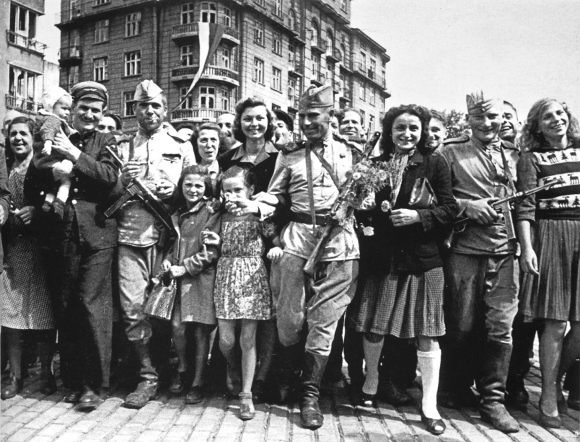
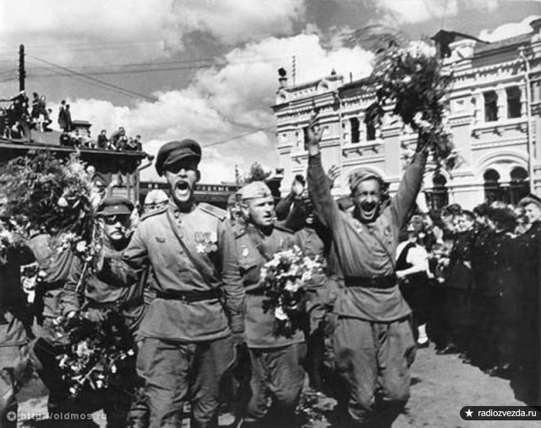
People all over the world were happy
when the war over.

Slide 12
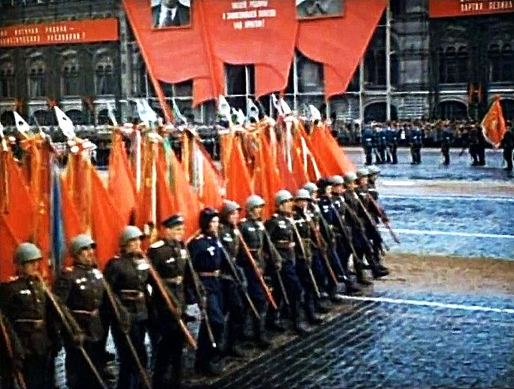
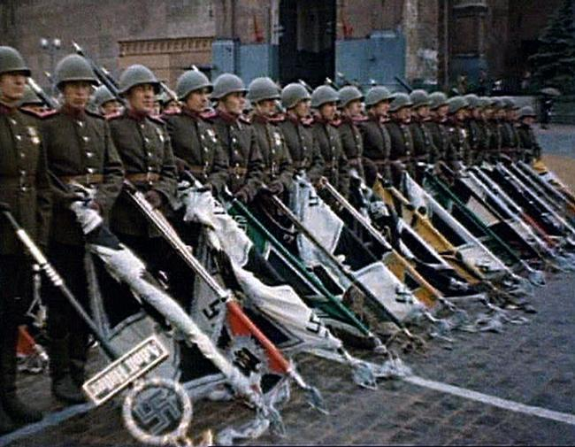
On June 24, 1945, the Parade of Victory
took place on Red Square.

Slide 13
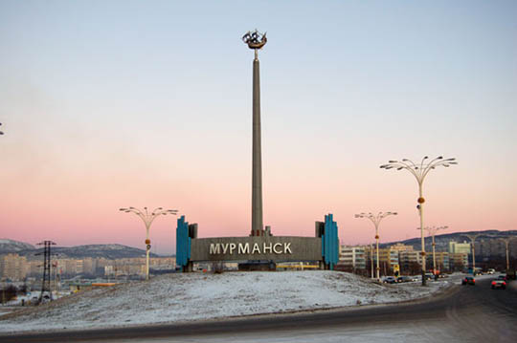
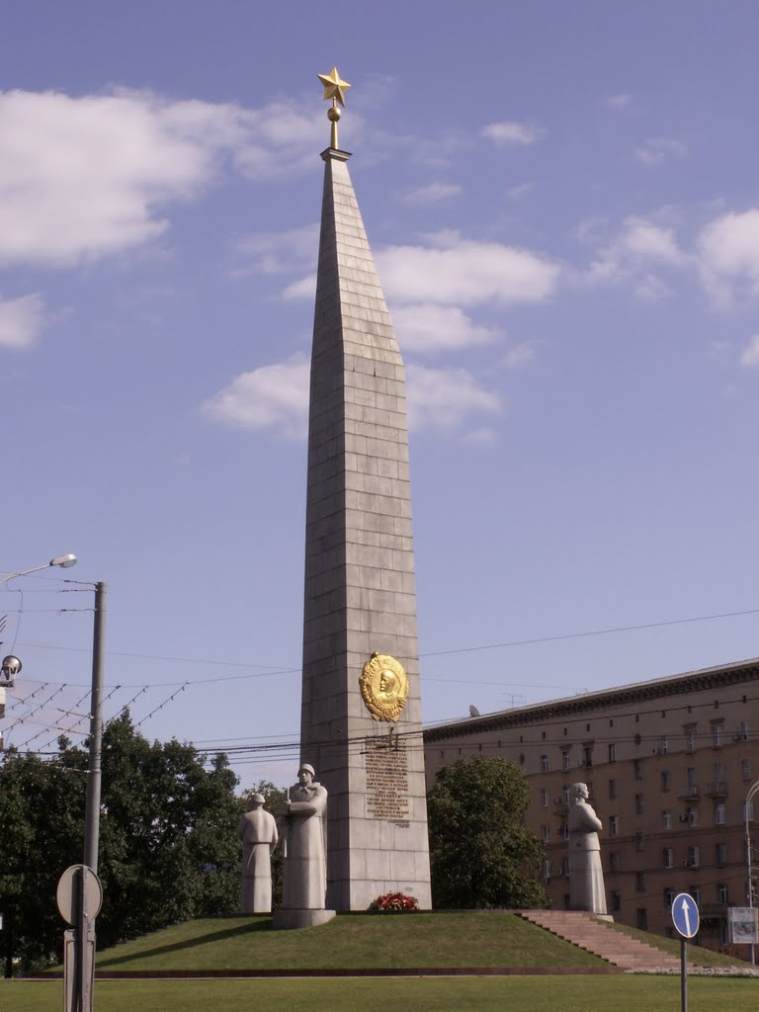
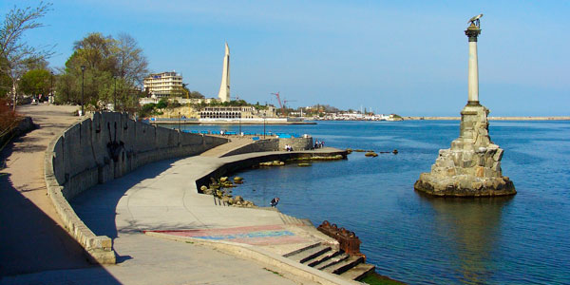
The people of our country had to fight
against the fascists from the White Sea
in the north to the Black Sea in the south.

Slide 14
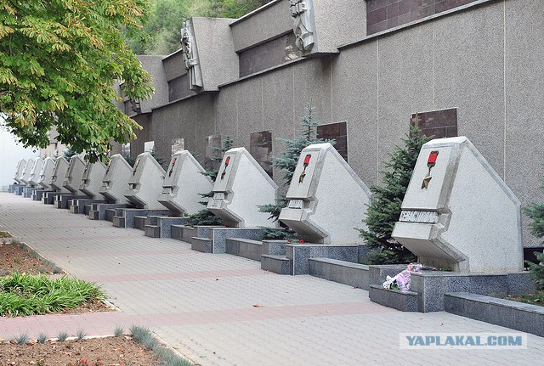
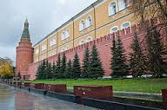
There are several Hero Cities in our country:
Murmansk, Leningrad, Brest, Minsk, Tula,
Moscow, Smolensk, Volgograd, Kiev, Kerch,
Odessa, Sevastopol, Novorossiisk.

Slide 15
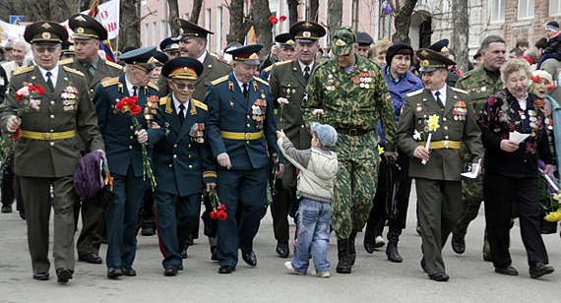
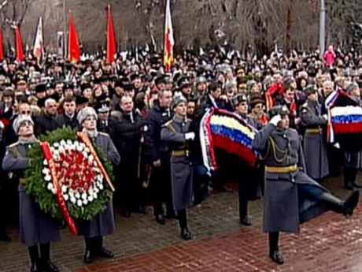
That spring day of May 9 went down in the history of our country as Victory Day.
It is celebrated by meetings and marches.
People bring flowers to the monuments
where war heroes lie.

Slide 16
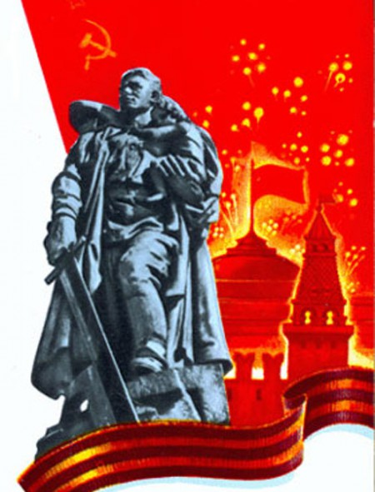
The victory was won at a high price.

Slide 17
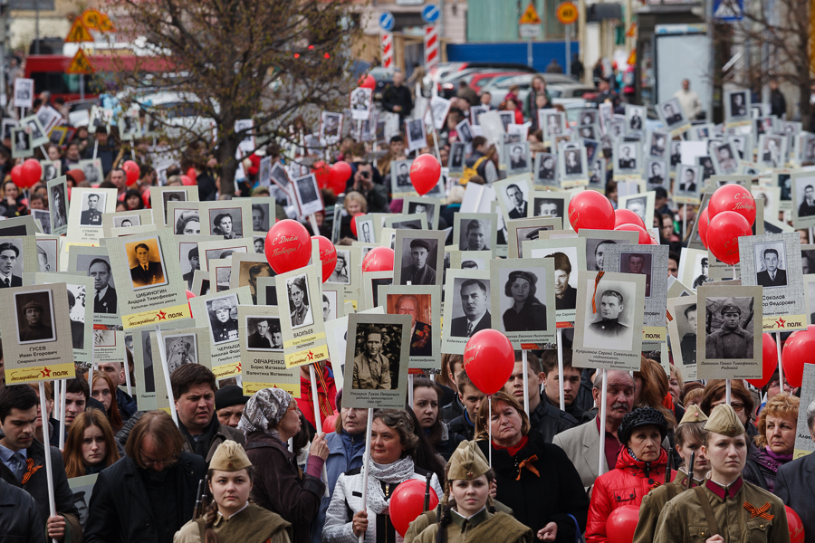
We have the right to work, to be happy, to love, but we have no right to forget those people who didn’t come back home from the war.

Slide 18
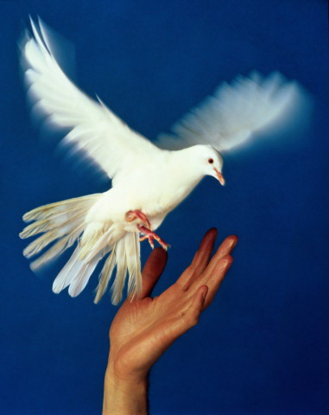
On a bright day, on a light day,
A bird I see for you and me.
A bird so white, a bird so bright,
A bird we love, the White Dove!
It sings a song of peace, my dove,
A song so sweet and free;
A song of peace, a song of love,
A song for you and me.
The bird so white, the bird so bright,
The bird we love, the White Dove!

Slide 19
