Slide 1
English-speaking countries of the world

Slide 2
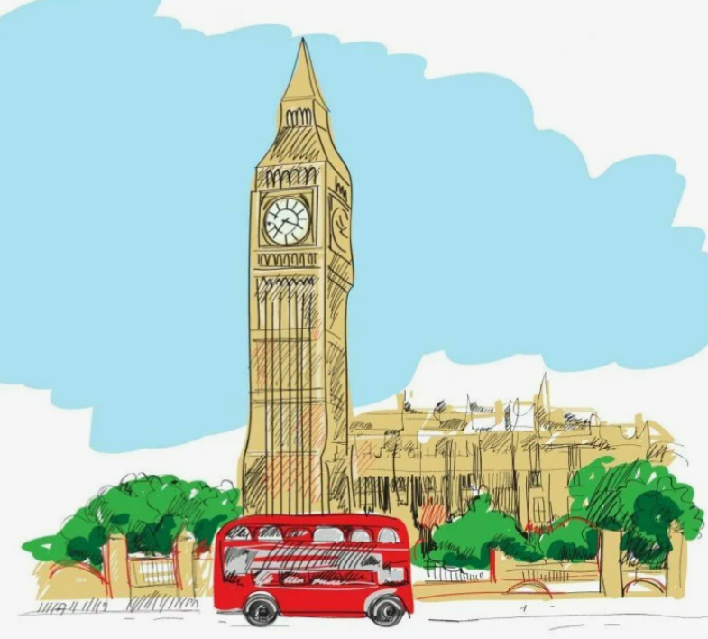
Where is Big Ben?
A) In Oxford
B) In Cambridge
C) In London

Slide 3
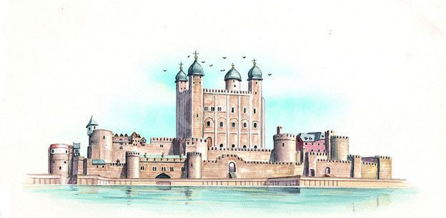
The Tower of London is
A) a palace
B) a museum
C) a zoo

Slide 4
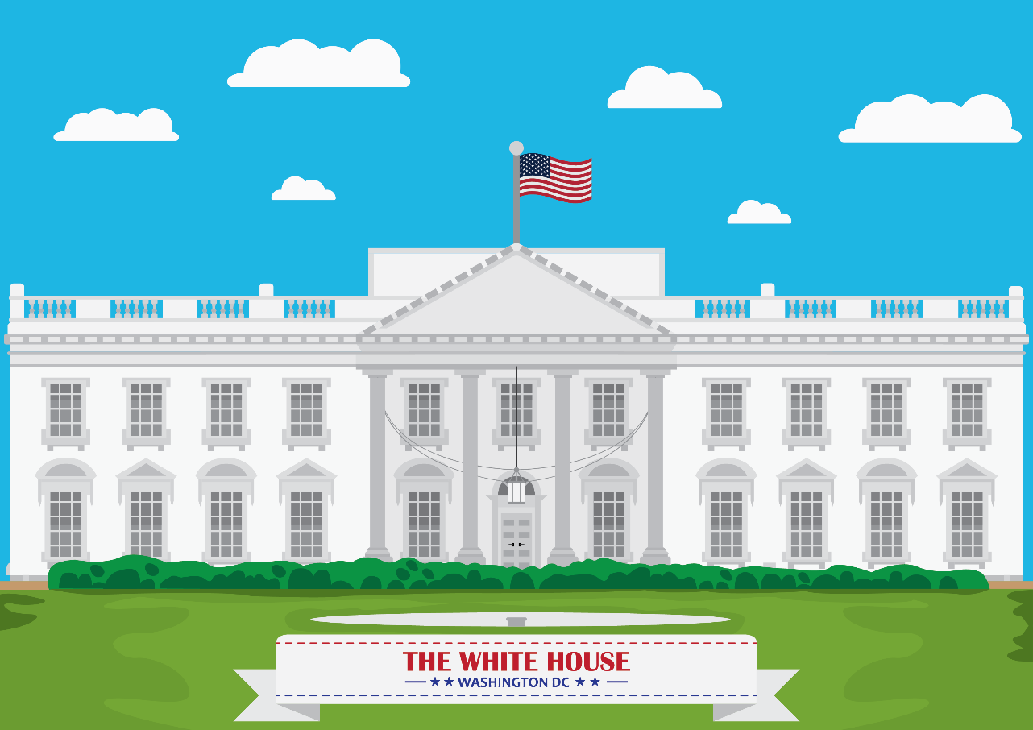
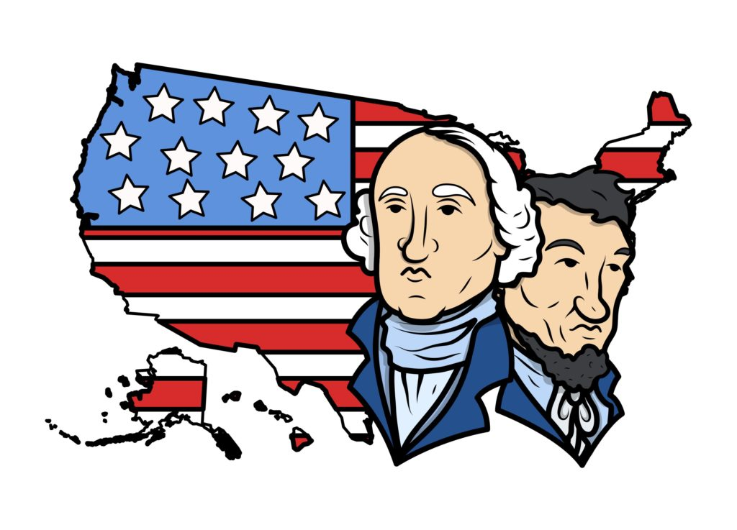
Who lives in the White House in Washington D.C.?
A) The king
B) The queen
C) The president

Slide 5
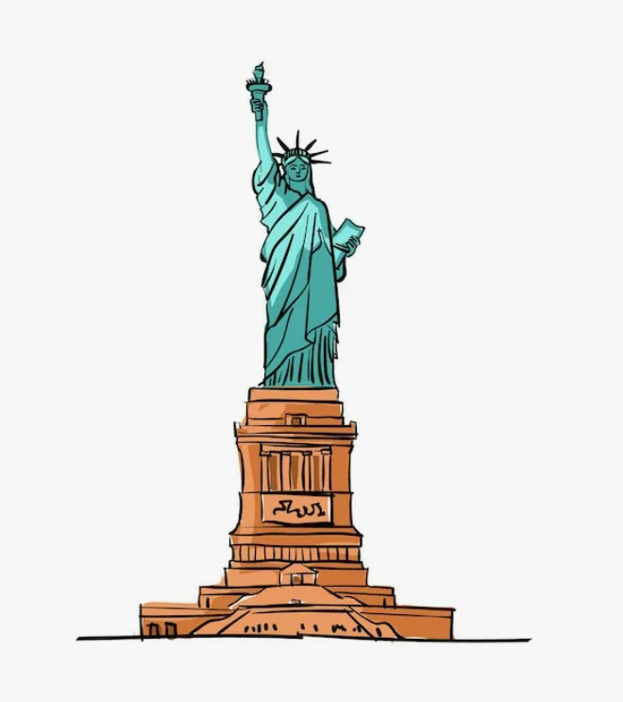
The Statue of Liberty is in
A) Washington
B) New York
C) Dublin

Slide 6
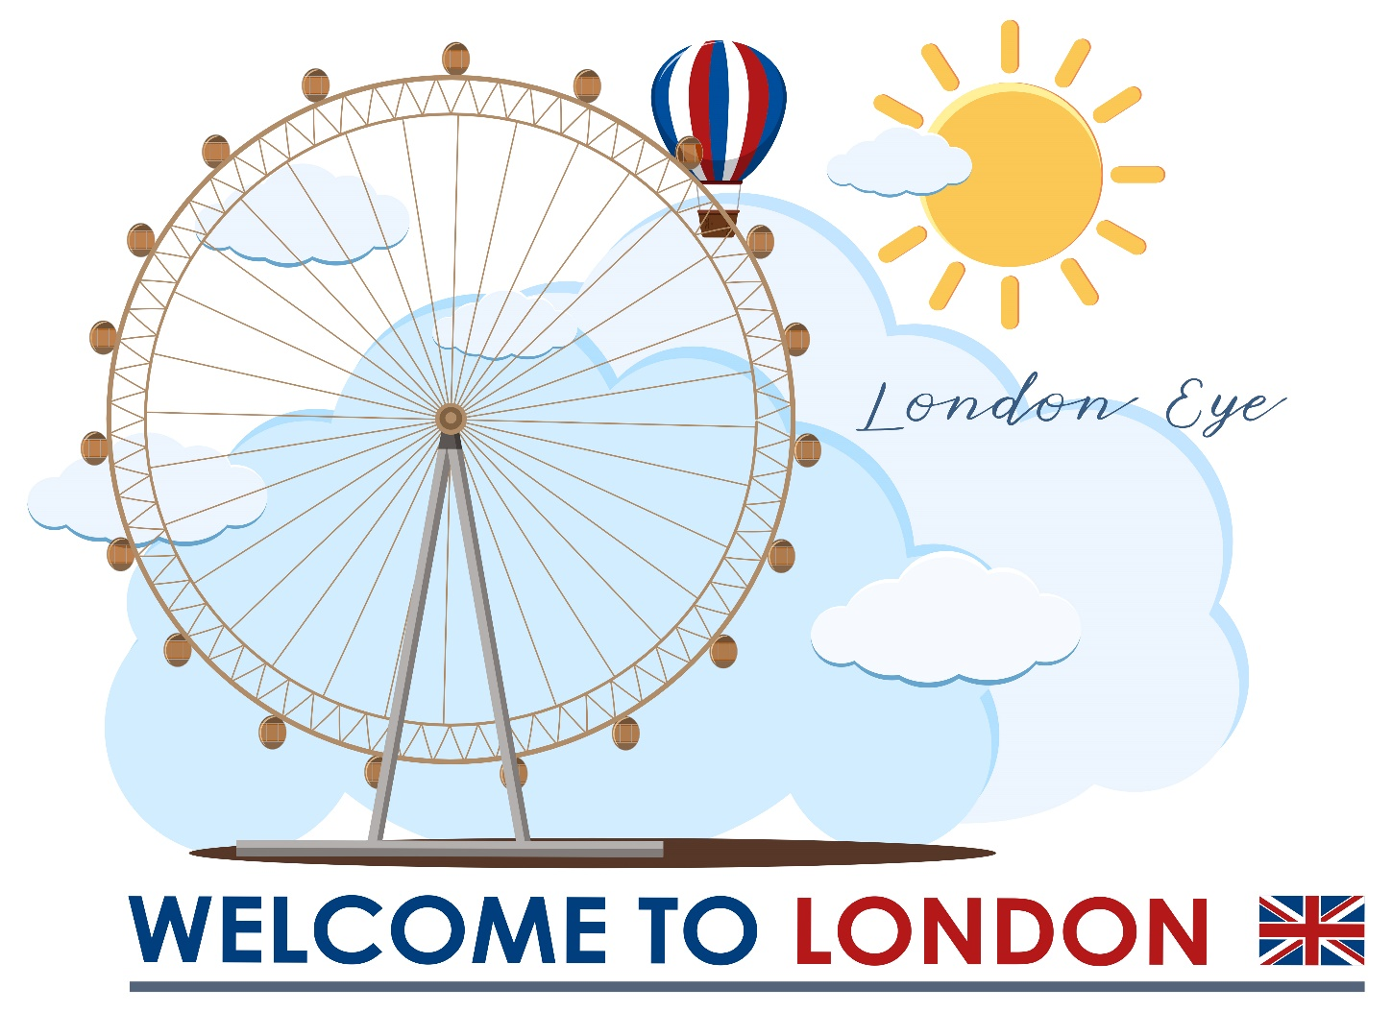
You visit the London eye
A) to go on a ride
B) to see an eye doctor
C) to have lunch

